Slide 1

Cloud based application
6511286 Jan Poonthong
6511566 YoonWaddyMyoMyint
6510866 ChitSuThuzar
6511148 Waddy Than Htike

Slide 2
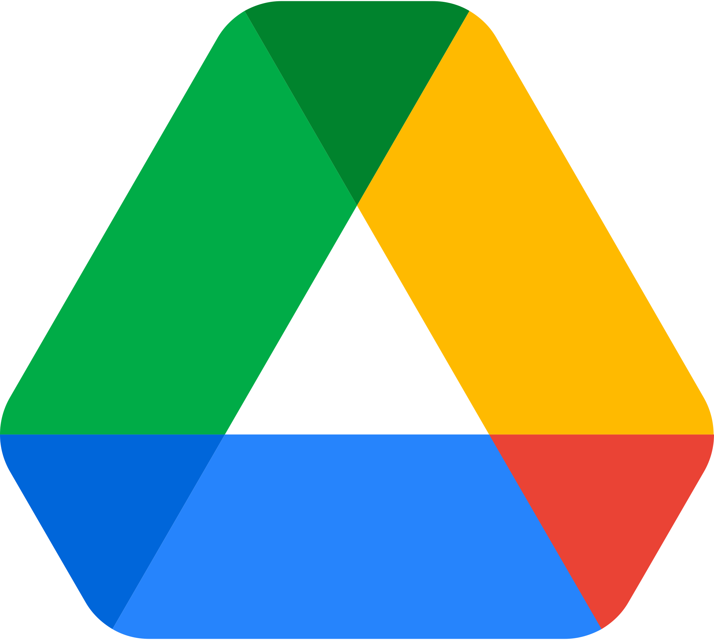
Google drive
Powerful and one of popular cloud-based applications
Freeing up space on your device for more important and bigger files
Runs in any device with any connection by one same Google account
(SaaS cloud apps)

Slide 3
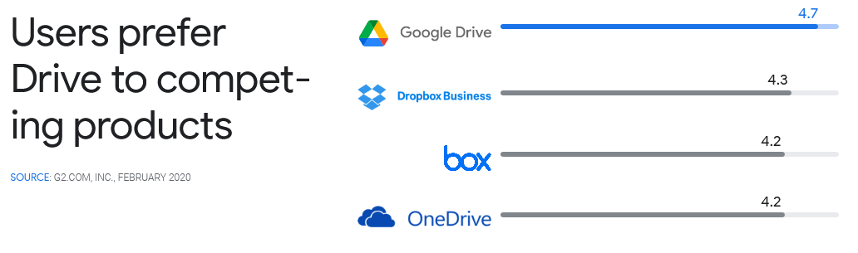
Why users prefer "Google drive"?
It enables users to work both online and offline on a file
Continue work offline and sync information and update the file automatically
Doesn't need to pay for a license in software update

Slide 4
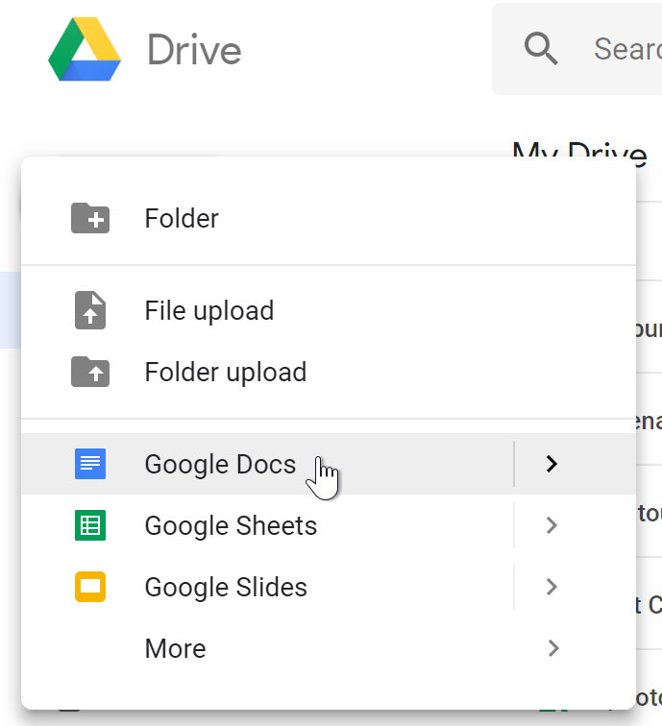
It has its own Office suit
It is flexible
a sort of network with API service integrations
a remote cloud storage service solution offered by Google

Slide 5
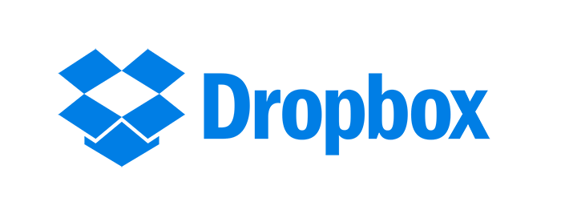
What is Dropbox ?​
A cloud storage service
Enables saving files online and sync them to devices
Using Dropbox links to share files and folders without sending large attachments

Slide 6
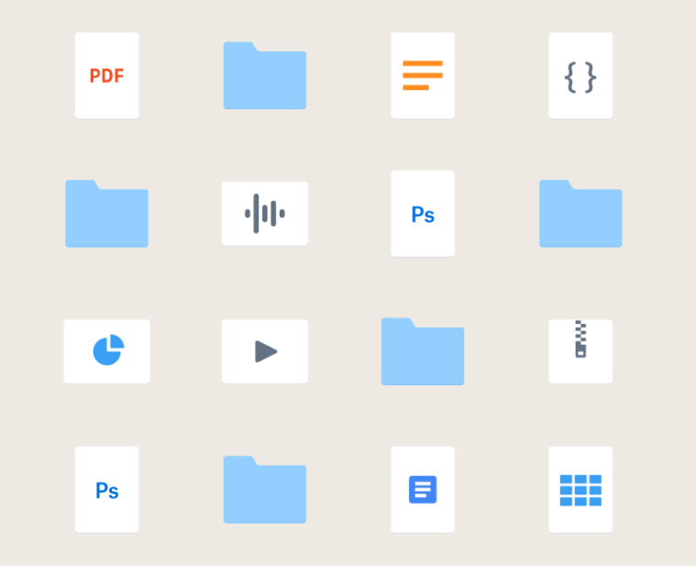
Store any file or folder
No matter the file or folder you’re trying to save—from photos and videos to large CAD files and PowerPoint presentations—you can store it safely using cloud storage solutions from Dropbox.

Slide 7
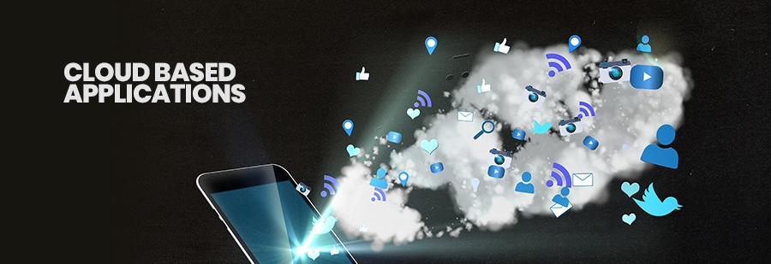
Why should I use Dropbox as my cloud storage service?
Dropbox offers various cloud storage options. Whether you're an individual, small business, or large company, using Dropbox for cloud storage lets you store everything safely in the cloud and access file uploads from multiple devices.

Slide 8

Benefits
Easy to use
Security
Work without internet connection

Slide 9

Amazon Web Services
Amazon Web Services, Inc. is a subsidiary of Amazon that provides on-demand cloud computing platforms

Slide 10
What is Amazon Web Services for?
Amazon web service is an online platform that provides scalable and cost-effective cloud computing solutions.
AWS is a broadly adopted cloud platform that offers several on-demand operations like compute power, database storage, content delivery, etc.
help corporates scale and grow.

Slide 11
How AWS is a cloud-based application?
Free data storage in the cloud (images (ws3))
Free remote severs to let businees host their product or services
Website or application for hosting service to run their APIs
cost-effective cloud computing solutions

Slide 12
References
HTTPS://WIREDELTA.COM/HOW-WAS-GOOGLE-DRIVE-DEVELOPED/ HTTPS://WWW.MAKEUSEOF.COM/WHY-GOOGLE-DRIVE-IS-IDEAL-CLOUD-STORAGE/
https://en.wikipedia.org/wiki/Dropbox
https://www.dropbox.com/features/cloud-storage
https://datascope.io/en/blog/7-benefits-of-using-dropbox/
https://www.google.com/url?sa=t&rct=j&q=&esrc=s&source=web&cd=&cad=rja&uact=8&v
https://en.wikipedia.org/wiki/Amazon_Web_Service

